Slide 1
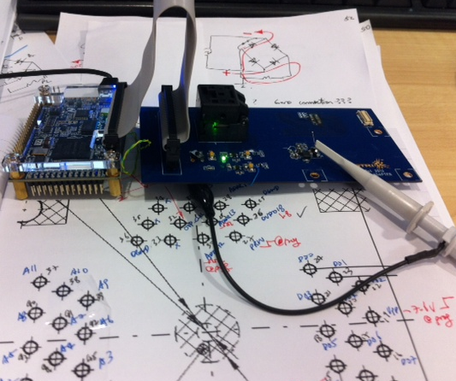
Henry
BSN ASIC V.2 programming platform
Programming board modifications and FPGA programming
Trouble shooting with Ching-Mei and ASTRI
Inductive link
Large drop in recovered power during data read back
Working on better schemes of data modulation

